Slide 1
Intro to Avoiding Plagiarism and Finding Credible Online Sources
English IV Research Process: Mrs. Smith

Slide 2
Objectives
Define plagiarism and identify various types so you will know how to avoid it.
What do you already know about avoiding plagiarism? Take this quiz to find out.

Slide 3
What is plagiarism?
Watch this YouTube video.
Forms of plagiarism

Slide 4
Objectives (continued)
Compare and contrast the types of Internet domains (e.g., .com, .org, .edu, .gov, .net, .mil).
Demonstrate proficiency using search engines, including Boolean search techniques.
Evaluate online information for credibility and quality using basic guidelines and indicators (e.g. authority, affiliation, purpose, etc.).
What do you already know about these objectives? Take this quiz to find out.

Slide 5
Search Strategies
When searching for info for a project, paper, or assignment, do you sometimes find too much information? Or not enough? Use Boolean search techniques and tips from Google to avoid this problem.

Slide 6
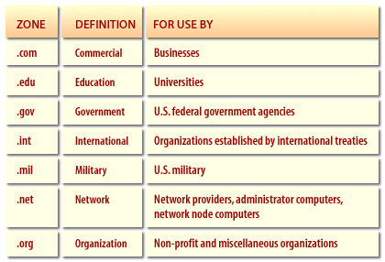
Domain Names
Even when using Boolean search techniques, you’ll usually still have more results than you need. So, how do you determine which ones are most reliable to narrow them down?
First, look at domain names:

Slide 7
Evaluating Sources
Don’t rely on domain name alone to determine a website’s credibility. Use the CRAAP method
“What’s Wrong With Wikipedia?” and 25 Biggest Blunders in Wikipedia History
However, Wikipedia can be a good starting point because it provides links to resources that ARE credible (at the bottom) as well as many copyright-free images that you can use for school assignments.
Why IS there so much inaccurate information online? Think about it and take the Smart Surfer quiz.

Slide 8
Use the Media Center webpage to help you!
Resources for Projects
Citation Resources

Slide 9
Research Process Task #1
Find 5 credible sources on your topic.
Start with the sources on the Media Center page.
If you need additional sources, use Boolean search techniques and the criteria we discussed today to find accurate information online.
Remember that you will be required to use information from all 5 of your sources. Look for sources with varied information that you can easily understand.
If having trouble finding good sources, ask for help! ☺
Complete Evaluating Websites chart to determine the credibility of each source. Add Websites 4-5 on the back. Submit the completed chart to Ms. Simpson/Ms. Maxwell.

